Slide 1
COLUMBIA
ASIA HOSPITAL
Vaibhav Mishra

Slide 2
Problem statement
You have been hired as a consultant data analyst by Columbia Asia Hospital. The Hospital is looking for key insights for the following objectives:
Assess the hospital's revenue generation
Insights about suitable departments for new hires
Strategies suggestions for patient discounts
Your task is to perform data analysis and come up with a report in order to help the organisation with the mentioned objectives.

Slide 3
Data description
Date: This column contains date and time information without specifying AM or PM. The format is DD-MM-YYYY HH:MM.
Patient ID: Each patient is assigned a unique identifier, which seems to be in the format 124-62-3289.
Patient Gender: This column records the gender of the patient, denoted by 'M' for male and 'F' for female.
Patient Age: The age of the patients is listed in years.
Patient Sat Score: It seems to represent a satisfaction score given by or for the patient. However, the scores are single-digit, and it's not clear what the scale is.
Patient First Initial: This column contains the first initial of the patient's first name.
Patient Last Name: The surname of the patient is listed in this column.

Slide 4
Patient Race: The racial or ethnic background of the patient is recorded here, with categories such as 'White', 'African American', 'Asian', 'Native American/Alaska Native', and 'Two or More Races'.
Patient Admin Flag: This column contains boolean values ('TRUE' or 'FALSE') which might indicate whether the patient was admitted or some other administrative flag.
Patient Wait Time: Appears to indicate the time the patient waited, possibly in minutes, before being seen or processed.
Department Referral: This column lists the department to which the patient was referred, with entries such as 'General Practice', 'Orthopedics', 'Gastroenterology', or 'None' indicating no referral.
Doctor Name: Identifies the doctor who attended each patient.
Appointment Fees: The cost charged for a doctor's consultation.
Total Bill: The overall amount billed to the patient, including all services and charges.

Slide 5
OBJECTIVE
KEY METRICS
AND
VISUALISATIONS

Slide 6
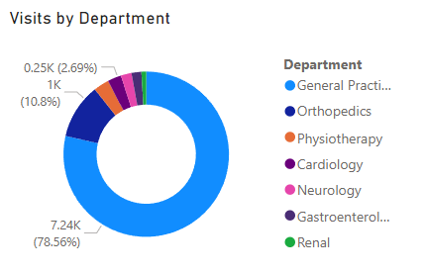
Visits by department
Insights:
General Practice department has the greatest number of visits.
Renal Department is experiencing the least number of patient visits.

Slide 7
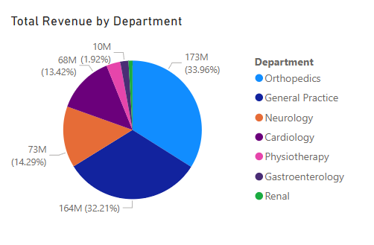
Revenue by department
Insights:
Orthopaedics department is the largest contributor to the revenue generated.
Orthopaedics and General Practice departments are significant leader in terms of revenue.
Renal department has significantly lower revenue contribution.

Slide 8
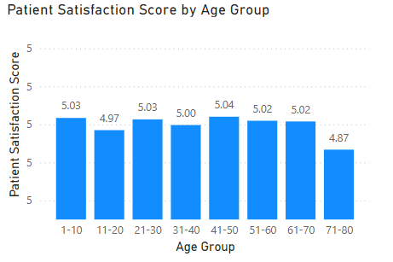
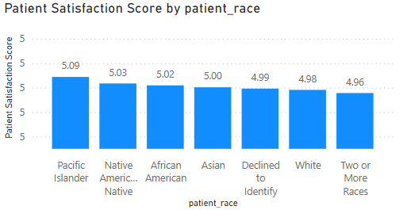
Satisfaction rating by demographic
Insights:
The Age group 71-80 has the least average satisfaction scores among the patients.
The range between races is not very varied for average satisfaction scores.

Slide 9
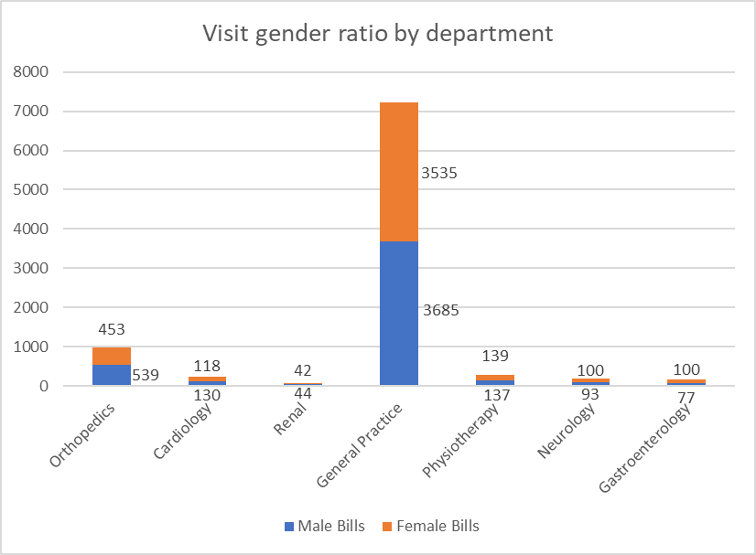
Gender ratio by department
Insights:
Physiotherapy is the most gender-neutral department with similar number of male and female bills.
Gastroenterology has significantly more female patients than male.
Majority of departments have male dominated patient pool.

Slide 10
SUBJECTIVE
INSIGHTS
AND
RECOMMENDATIONS

Slide 11
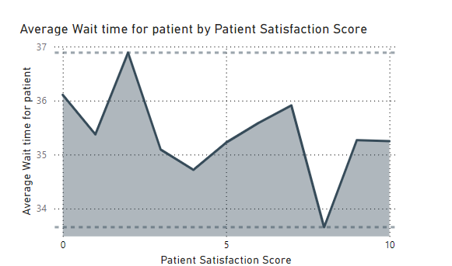
Average wait time by satisfaction score
Insights:
The average wait time is in the range of 33-37 minutes.
The max average wait time for patient is for satisfaction 2 while the lowest is for 8.
There seems to be no relation between patient time and satisfaction scores.
Recommendations:
Efforts to reduce patient wait time through more hospital staff.
Look for other factors influencing patient satisfaction scores.

Slide 12
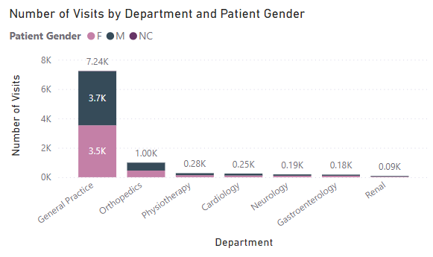
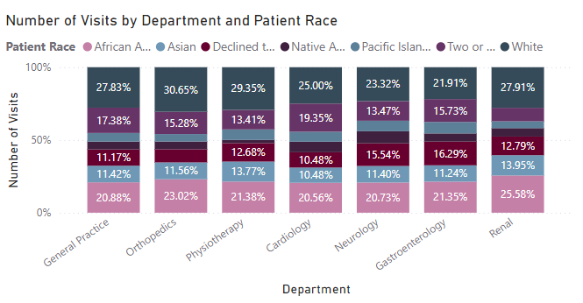
Number of visits by patient demographic

Slide 13
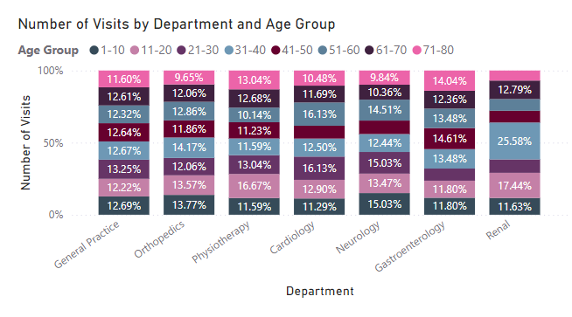
Number of visits by patient demographic
Insights:
Patient data shows that the visits are gender-neutral with similar male and female patients.
White and African American constitute approximately 50% of patients in almost every department.
Patients are equally distributed among their age groups in every department except Renal where age group 31-40 is in majority.
Recommendations:
Efforts to reduce patient wait time through more hospital staff.
Look for other factors influencing patient satisfaction scores.

Slide 14
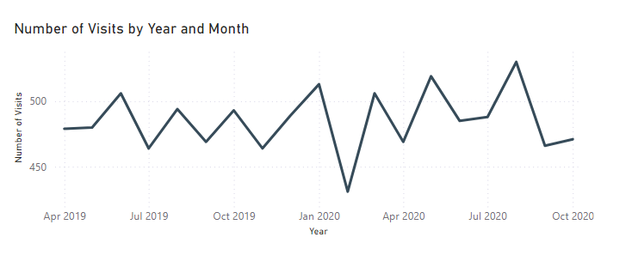
Year and month visit breakdown
Insights:
Number of visits were least in Feb 2020.
There are no 3 consecutive months where the number of visits either only increased or only decreased.
Recommendations:
Discounts and drives should be offered seasonally to increase visits.
Promotional drives and free checkups can be offered to increase patient visits.

Slide 15
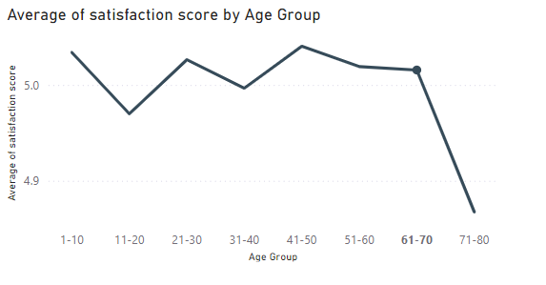
Average sat score by patient age group
Insights:
Average Satisfaction rating of age group 71-80 is lowest among all the age groups.
1-10 and 41-50 age groups have the highest average satisfaction rating.
Recommendations:
Amenities like wheelchairs and a hospital staff worker can be assigned to the senior patients.
In order to improve average rating in all the age groups number of staff can be increased in order to have a more personal interaction.

Slide 16
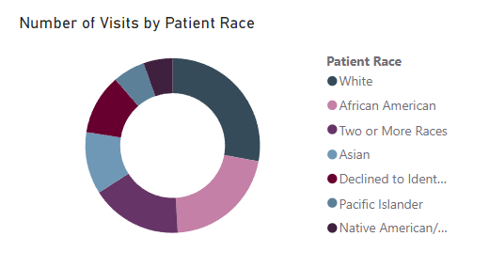
Patient diversity
Insights:
The patient pool is highly diverse with 7 different ethnicities.
Majority of patients belong to White and African American race.
Recommendations:
Public health drives can be promoted to ethnic communication channels.
Mobile clinics can be set up in areas where specific races are predominant.

Slide 17
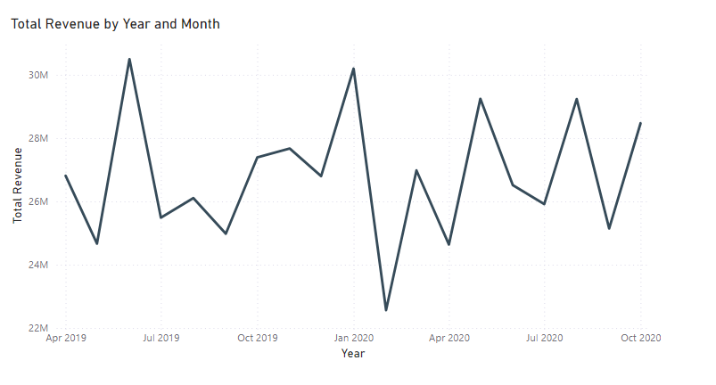
Revenue breakdown by year and month
Insights:
Average monthly revenue of the hospital lies in the range of 22-30 million.
The hospital is doing well in terms of revenue considering only 22 doctors are on call.
Recommendations:
Number of doctors can be increased in order to increase number of visits by patients.
Seasonal diseases can be anticipated in order to maximise productivity in that particular department.

Slide 18
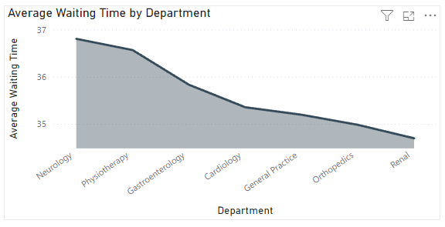
Average wait time by department
Insights:
Neurology department has the highest average waiting time among the departments.
The difference between average waiting time of different departments is not that significant and the range lies in 34-37 minutes of waiting.
Recommendations:
Efforts to reduce patient wait time through more hospital staff.
Look for other factors influencing waiting time for the patient.

Slide 19
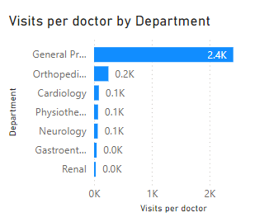
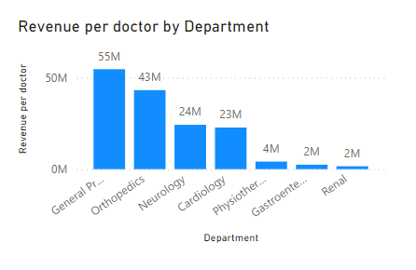
Doctor productivity
Insights:
Departments with consistently high patient volumes or significant growth trends often require additional doctors to manage patient loads effectively.
High patient volume can lead to long wait times, which impact patient satisfaction and outcomes.
Some departments may already have a higher patient-to-doctor ratio, making it challenging to maintain quality of care. Reducing this ratio can improve patient outcomes and doctor workload balance.
High-revenue departments or those with elective procedures can justify the investment of new doctors due to their potential for positive ROI.
Recommendations:
General Practice has the highest number of visits, new recruits should be done in this department do decrease workload and improve customer satisfaction.
Orthopaedics has a small number of patients but it is very high in revenue per doctor. This fact can be used to increase revenue by increasing number of visits through referrals.

Slide 20
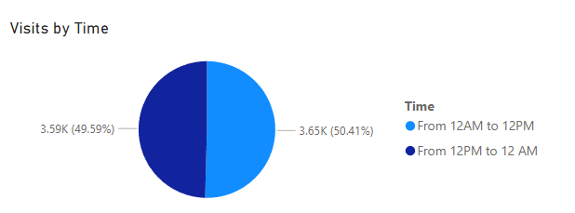
Shift allocation
Insights:
Looking at visit times, the patient visits are symmetric around the time of noon.
For General Practice, patients equally come from noon to midnight and from midnight to noon.
Recommendations:
The two shift timings should be 12am-12pm and 12pm-12am.
This timing will ensure patients have the best care possible while also ensuring the staff gets enough rest.
This 2-shift policy will improve satisfaction scores as well as quality of care.

Slide 21
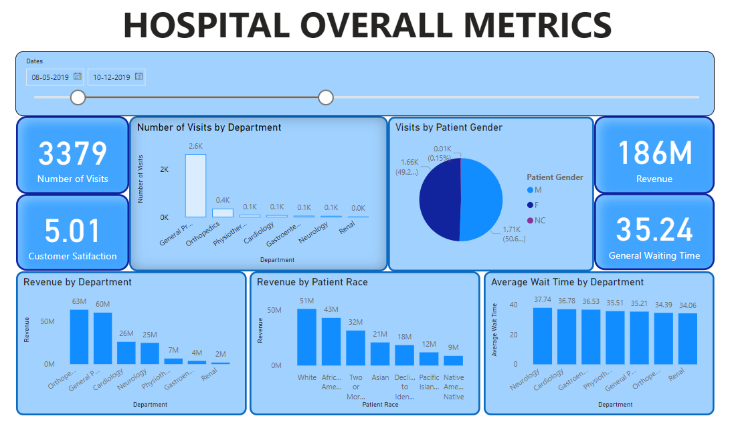
Dashboard

Slide 22
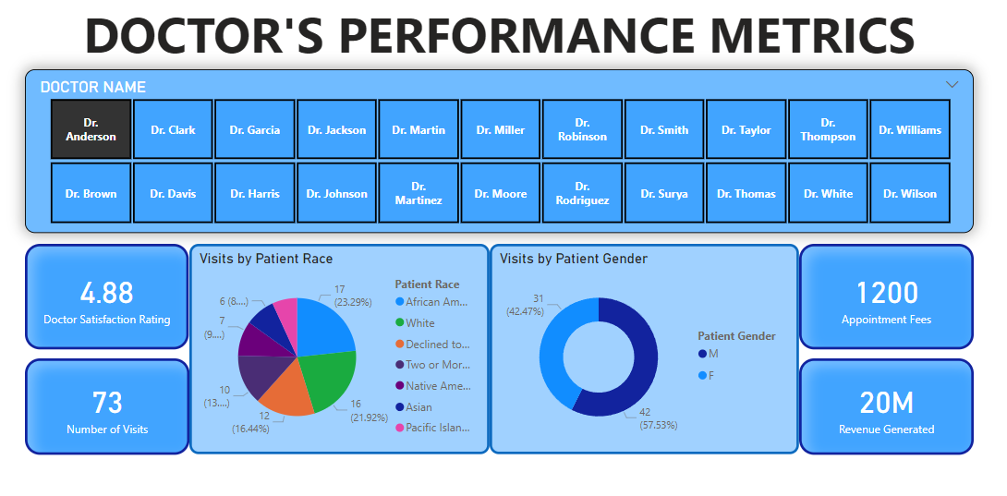

Slide 23
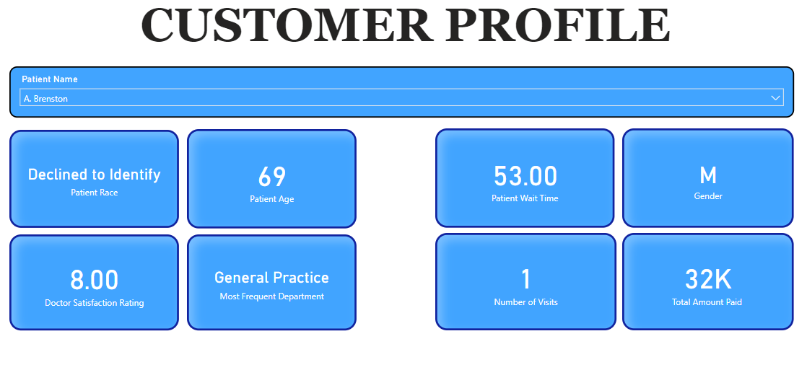

Slide 24
Recommendations
General Practice has the highest number of visits, new recruits should be done in this department do decrease workload and improve customer satisfaction.
The 2-shift policy will improve satisfaction scores as well as quality of care.
Public health drives can be promoted to ethnic communication channels.
Mobile clinics can be set up in areas where specific races are predominant.

Slide 25
Conclusion
Columbia Asia Hospital has huge potential to become a highly successful medical care enterprise.
The hospital has high revenue potential.
Discounts and offers will attract more people for their caregiving.
Orthopaedic department has huge revenue potential if patient visits can be increased.

Slide 26
Acknowledgement
Microsoft Power BI documentation.
Microsoft Learn Portal
DAX Studio Org

